Slide 1
Social Security Administration Data Set

Slide 2
About this project:
The Social Security Administration (SSA) releases data every so often about the state of the disability system in the United States.
In addition to helping informing voters, give numbers for various media outlets to talk about, etc. Various businesses can use the data in order to

Slide 3
Exploratory Data Analysis (EDA)
In order to understand a set of data, it is important to see trends and interactions between different variables.
The most common way to do this is through plotting out the data. Both adult population and the adult disability rate were plotted and grouped by region to see how some of these variables behaved and give us insight into what model(s) we should use.

Slide 4
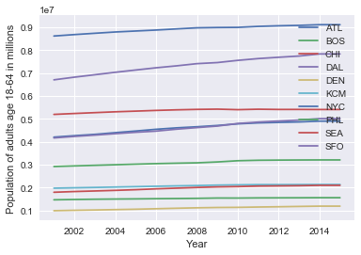
Adult population growth by region

Slide 5
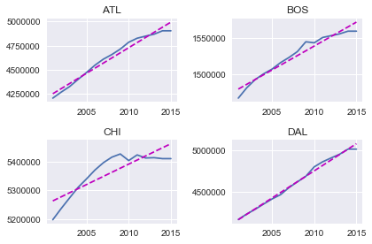
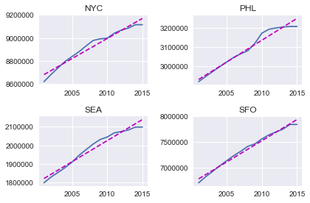
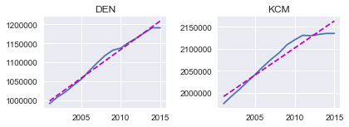
Adult Population of Regions plotted individually.

Slide 6
Adult population growth by region
Initially looking at the population, all regions appear to be very highly correlated with each other. In fact, the lowest correlation between regions was between Dallas and Chicago at 0.86.
A breakdown of how individual state population fluctuate within regions is plotted on the following slides. The effects of major events is evident in some of these charts.

Slide 7
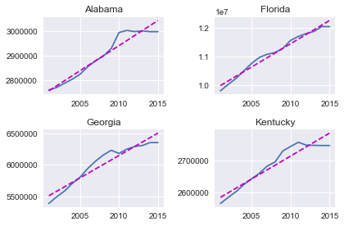
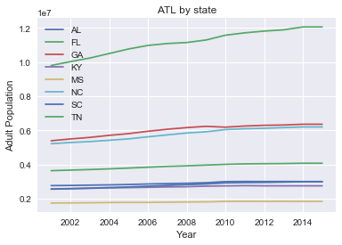
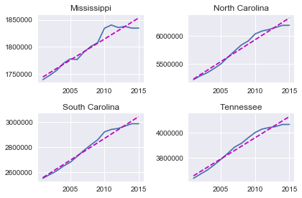
Atlanta Region
Although Florida may seem like an outlier, The data is in fact accurate and matches that in other data sets on the web.

Slide 8
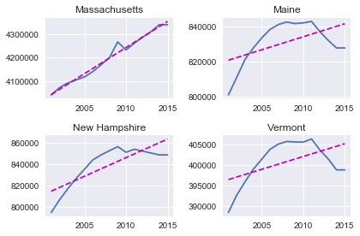
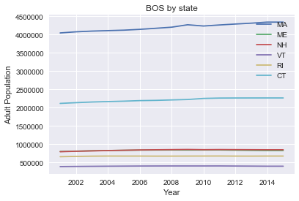
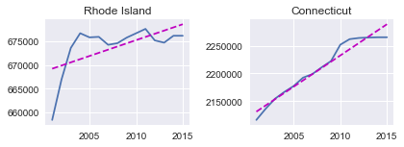
Boston Region
New Hampshire, Vermont, and Maine all have very similar trends in population since they all share the same forest and mountain geography. Rhode Island has been struggling to build industry since losing manufacturing to overseas.

Slide 9
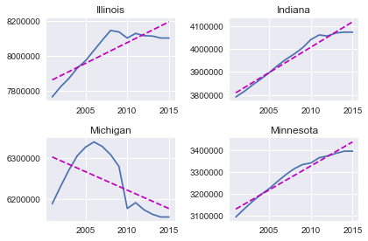
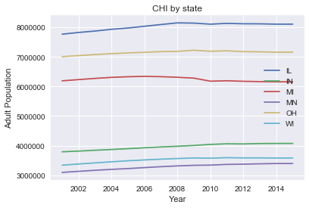
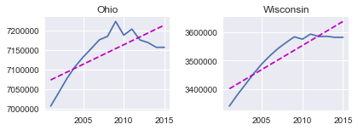
Chicago Region
Michigan was hit especially hard by the financial crisis and lost many jobs related to the auto industry, which it relied heavily on. Ohio is also losing jobs, especially in manufacturing which could be related to the decline in it's youth population. Illinois has had a steady decline for some time and consensus on the web seems to be tax related. Their severe financial burden is chasing residents out in addition to the state's stagnant growth.

Slide 10
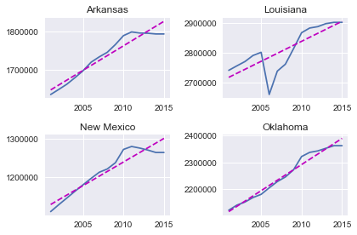
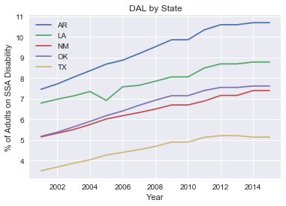
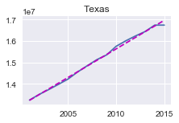
Dallas Region
New Mexico is also accurate, despite appearing as wrong data. Louisiana looks especially hard hit from Hurricane Katrina, but has since rebounded quickly.

Slide 11
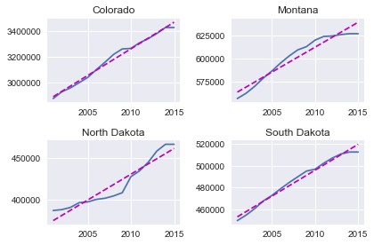
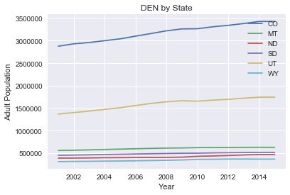
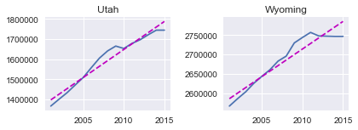
Denver Region

Slide 12
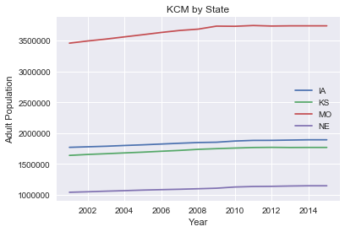
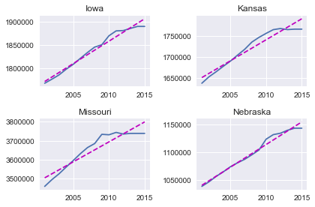
Kansas City Region

Slide 13
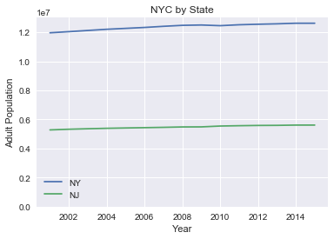
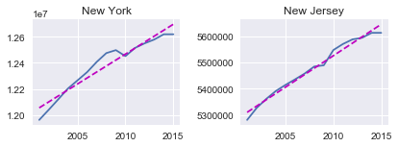
New York City Region

Slide 14
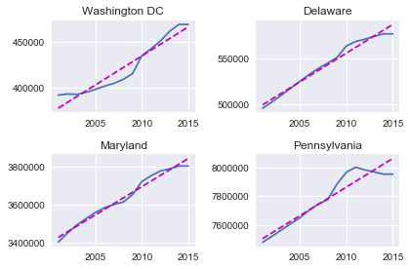
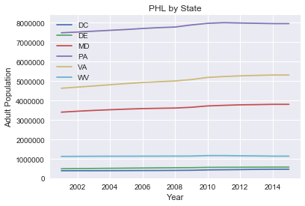
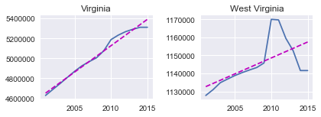
Philadelphia Region
The phenomenon in West Virginia showing a sharp increase in population then back down was confirmed in other datasets as true data.

Slide 15
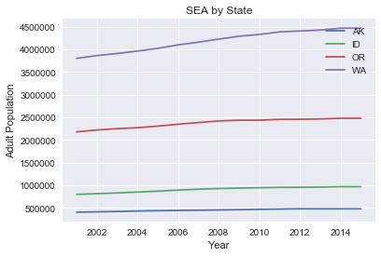
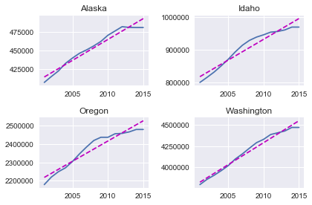
Seattle Region

Slide 16
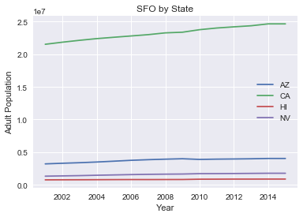
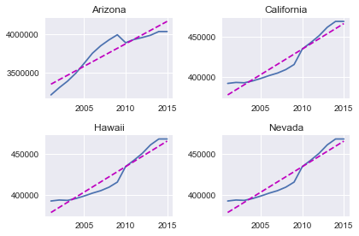
San Francisco Region

Slide 17
Adult Disability Rate
Next column explored is adult disability rate. This is the percentage of people age eighteen through sixty-four that are currently on disability.
Later on, we will use this feature as target variable in our model.
The rates were plotted individually and then again by state.

Slide 18
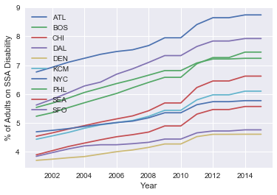
Disability Rates by Region

Slide 19
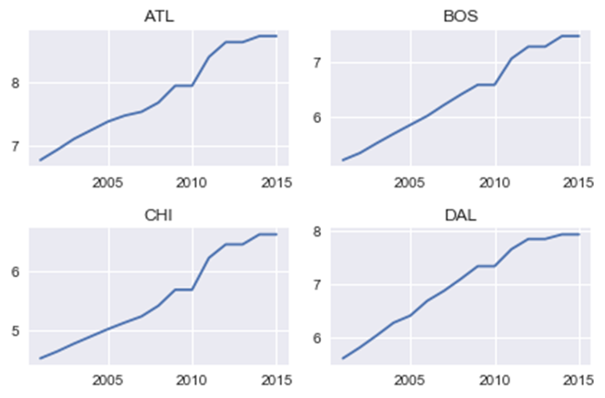
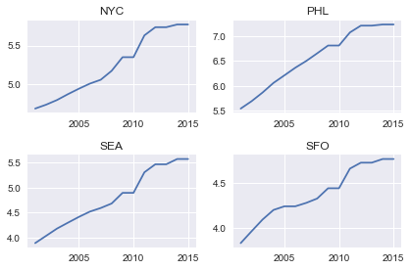
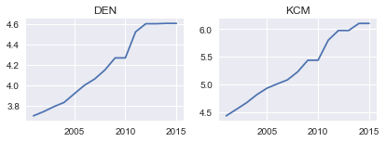
Regions plotted individually
Adult disability rates by region

Slide 20
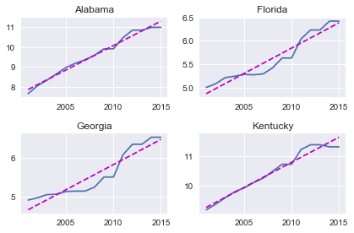
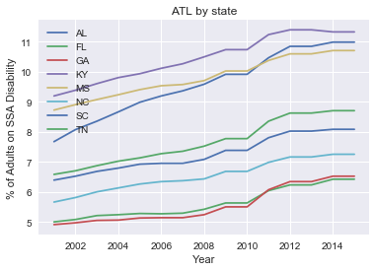
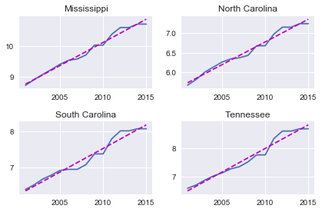
Atlanta Region

Slide 21
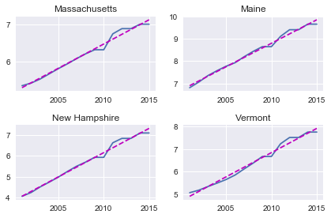
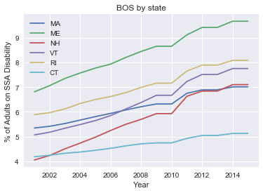
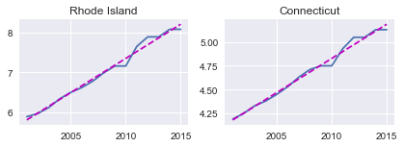
Boston Region

Slide 22
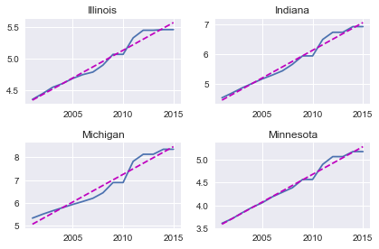
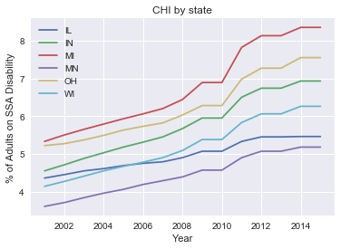
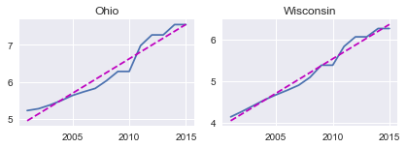
Chicago Region

Slide 23
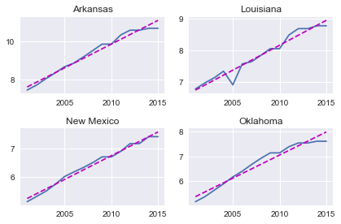
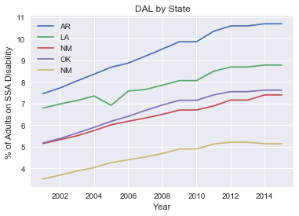
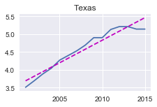
Dallas Region

Slide 24
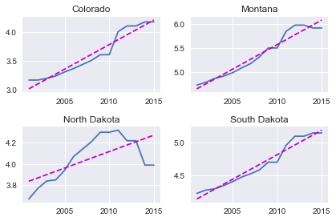
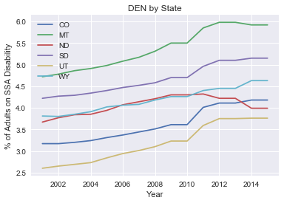
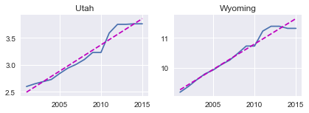
Denver Region

Slide 25
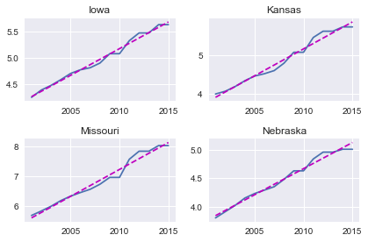

Kansas City Region

Slide 26


New York City Region

Slide 27



Philadelphia Region

Slide 28


Seattle Region

Slide 29


San Francisco Region

Slide 30
Correlation
Many of the population and percentages of adult disability on SSA disability appear to have some correlation with each other.
A correlation Pearson correlation test was done between population and the adult disability rate to see if this relationship was indeed true.
The next two slides have correlations broken down by both region and within states.

Slide 31
Correlation by Region
Region | Correlation | p-value
Overall | -0.092548924 | 0.010434449
ATL | -0.694608449 | 1.38419E-18
BOS | -0.271833772 | 0.009547709
CHI | 0.293177632 | 0.005041785
DAL | -0.641318153 | 5.6913E-10
DEN | -0.481353878 | 1.56513E-06
KCM | 0.870691433 | 1.59024E-19
NYC | 0.905963057 | 5.78157E-12
PHL | -0.220776939 | 0.036521464
SEA | 0.430472128 | 0.000596645
SFO | 0.358349498 | 0.004932691
Correlation between population and % of adults on SSA disability

Slide 32
Correlation by State
State | Correlation | p-value
Alabama | 0.968425231 | 3.20732E-09
Alaska | 0.986253664 | 1.50407E-11
Arizona | 0.775428211 | 0.000681921
Arkansas | 0.98585493 | 1.80955E-11
California | 0.977188497 | 3.95914E-10
Colorado | 0.949497324 | 6.48721E-08
Connecticut | 0.97267784 | 1.26541E-09
Delaware | 0.991209903 | 8.32079E-13
Florida | 0.922542655 | 9.79027E-07
Georgia | 0.822304881 | 0.000168076
Hawaii | 0.858100765 | 4.26607E-05
Idaho | 0.943296418 | 1.35652E-07
Illinois | 0.825692311 | 0.000149603
Indiana | 0.967193343 | 4.10102E-09
Iowa | 0.977041477 | 4.12651E-10
Kansas | 0.956469273 | 2.51213E-08
Kentucky | 0.974331269 | 8.46726E-10
State | Correlation | p-value
Louisiana | 0.779835574 | 0.00060643
Maine | 0.572185694 | 0.02582112
Maryland | 0.98372462 | 4.48096E-11
Massachusetts | 0.982475304 | 7.22512E-11
Michigan | -0.672829392 | 0.005982788
Minnesota | 0.968776376 | 2.98497E-09
Mississippi | 0.967425078 | 3.91854E-09
Missouri | 0.901944375 | 4.30894E-06
Montana | 0.948347477 | 7.4885E-08
Nebraska | 0.992902151 | 2.08107E-13
Nevada | 0.896313699 | 6.10826E-06
New Hampshire | 0.826840797 | 0.000143732
New Jersey | 0.976828525 | 4.37949E-10
New Mexico | 0.961593387 | 1.12693E-08
New York | 0.923586915 | 8.98655E-07
North Carolina | 0.974554129 | 8.00497E-10
North Dakota | 0.453281826 | 0.089716362
State | Correlation | p-value
Louisiana | 0.779835574 | 0.00060643
Maine | 0.572185694 | 0.02582112
Maryland | 0.98372462 | 4.48096E-11
Massachusetts | 0.982475304 | 7.22512E-11
Michigan | -0.672829392 | 0.005982788
Minnesota | 0.968776376 | 2.98497E-09
Mississippi | 0.967425078 | 3.91854E-09
Missouri | 0.901944375 | 4.30894E-06
Montana | 0.948347477 | 7.4885E-08
Nebraska | 0.992902151 | 2.08107E-13
Nevada | 0.896313699 | 6.10826E-06
New Hampshire | 0.826840797 | 0.000143732
New Jersey | 0.976828525 | 4.37949E-10
New Mexico | 0.961593387 | 1.12693E-08
New York | 0.923586915 | 8.98655E-07
North Carolina | 0.974554129 | 8.00497E-10
North Dakota | 0.453281826 | 0.089716362
Correlation between population and % of adults on SSA disability

Slide 33
Correlation
Hypothesis that the adult population was correlated with the rate of adults on disability returned with mixed results. Although most of the states came back with very high correlations, most of the regions came back with negative and weaker correlations. This was surprising seen as the regions exhibited high correlations when only considering population or rate of disability.
There is a chance that both of these variables happen to be correlated due to outside forces. Evidence of this could be seen in Michigan since with high correlations elsewhere, we would expect the rate to go down if it were true. As the sole state with a negative population growth, this may be a telling sign.

Slide 34



Comparing Disability Rate to Other Variables

Slide 35
Linear Regression using sklearn
Now that we have explored all 765 rows of our data, it is time to try to apply a model.
A linear regression model was applied using all 22 numerical features in the data set to find coefficients of the features.
Another linear model was then created using features that that used coefficients with a magnitude larger than one to improve the result.
The model was then applied to predict the rate for the country.

Slide 36

Linear Regression using sklearn
Predicted Rate | Standard Deviation | R²
5.85396924765 | 1.93172537739 | 0.906105057316

Slide 37
Breaking the Rate Down Further
Now that we have a model to predict using the whole dataset. Let’s try to break down these numbers into smaller groups.
We begin by attempting to cluster the regions together using clustering to see if we build a better model.
The ‘elbow graph’ on the following slide shows the result of the mean squared error as we increase the number of clustered used.
After the point K=3 clusters, the graph flattens off as adding more clusters does not explain much more of the variance.

Slide 38

Clustering by Region

Slide 39
Clustering on Regions
Clustering on region resulted in three clusters grouped as follows:
Cluster 0: Dallas
Cluster 1: San Francisco
Cluster 2: Atlanta, Boston, Chicago, Denver, Kansas City, New York, Philadelphia, Seattle
We will now apply linear regression to these clusters separately and see if we explain more of the variance.

Slide 40
Clustering on Regions
 | R²
Cluster 0 | 0.89557477004
Cluster 1 | 0.803402067542
Cluster 2 | 0.936030588144
Using the linear regression model by clustering did not have a large impact on the first cluster with just DAL.
The SFO region underperformed the model with only 80.3% of the variance explained by the model.
The third cluster with all the other values did better by a few percentage points, a decease of 3% from the original model.
Overall, this model could be considered an since we have some regions that we can predict with a higher degree of certainty.

Slide 41
Clustering by State
Since clustering by region gave a few useful pieces to use as a model, we will attempt to use clustering again by using the states instead.
A more refined breakdown may expose outliers and allow them to be plotted more accurately.
Again the ‘elbow graph’ recommends 3 clusters and we will use linear regression again to predict the adult disability rate.

Slide 42

Clustering by State

Slide 43
Cluster by State
 | States
Cluster 0 | AZ, CA, FL, GA, IL, MI, NC, NY
Cluster 1 | TX
Cluster 2 | AK, AL, AR, CO, CT, DC, DE, HI, IA, ID, IN, KS, KY, LA, MA, MD, ME, MN, MO, MS, MT, ND, NE, NH, NJ, NM, NV, OH, OK, OR, PA, RI, SC, SD, TN, UT, VA, VT, WA, WI, WV,WY

Slide 44
Clustering on State
 | R²
Cluster 0 | 0.988783044297
Cluster 1 | -5.63846713811
Cluster 2 | 0.9171397385
Cluster 0 has almost 100% of the variance explained by the model.
However, Cluster 1 had a negative R^2 which may have been caused by the sample being too small since it only contained Texas.
Cluster 2 preformed slightly better than the original model, but not by much.

Slide 45
Conclusion
Although feature selection did not improve the result over the model with all features, clustering was able to allow us build a better model by grouping states together that may not have been intuitive otherwise.
The model created by states preformed the best for every state except for Texas. For this state, we can fall back on the original model and use the new model for every one state.
Together they will work better than what we would have used otherwise.

